Slide 1

ONLINE FRUITS STORE
GROUP 14
蔡杰超 2230026003 胡云珂 2230026053
曹逸玮2230026008 丁书萱 2230026232
阮卓为2230026133 沐阳 2230026127

Slide 2

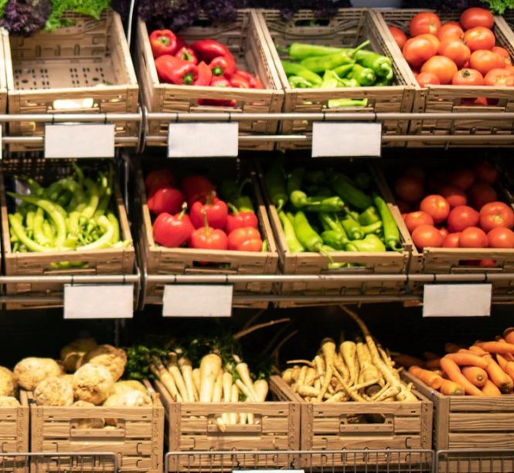
Contents
Register & login
Buyer
Seller
Admin
Cashflow

Slide 3
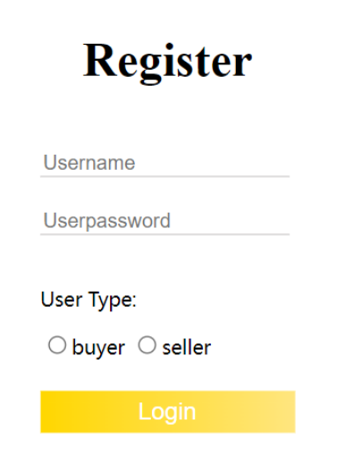
Register
A new user fills out a profile containing username, password and user type.
胡云珂

Slide 4
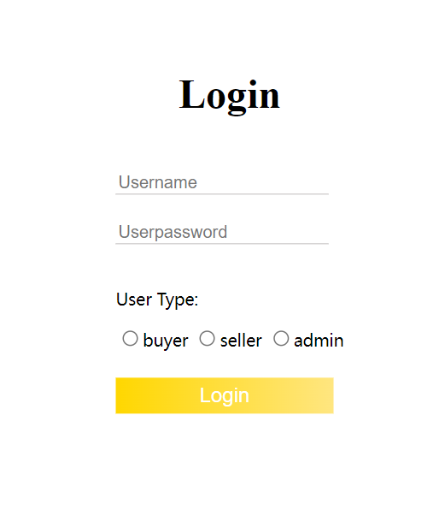
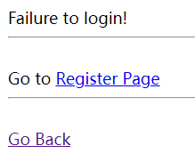
Login
Give warnings if blank
Give warnings if ID info doesn’t match
胡云珂

Slide 5
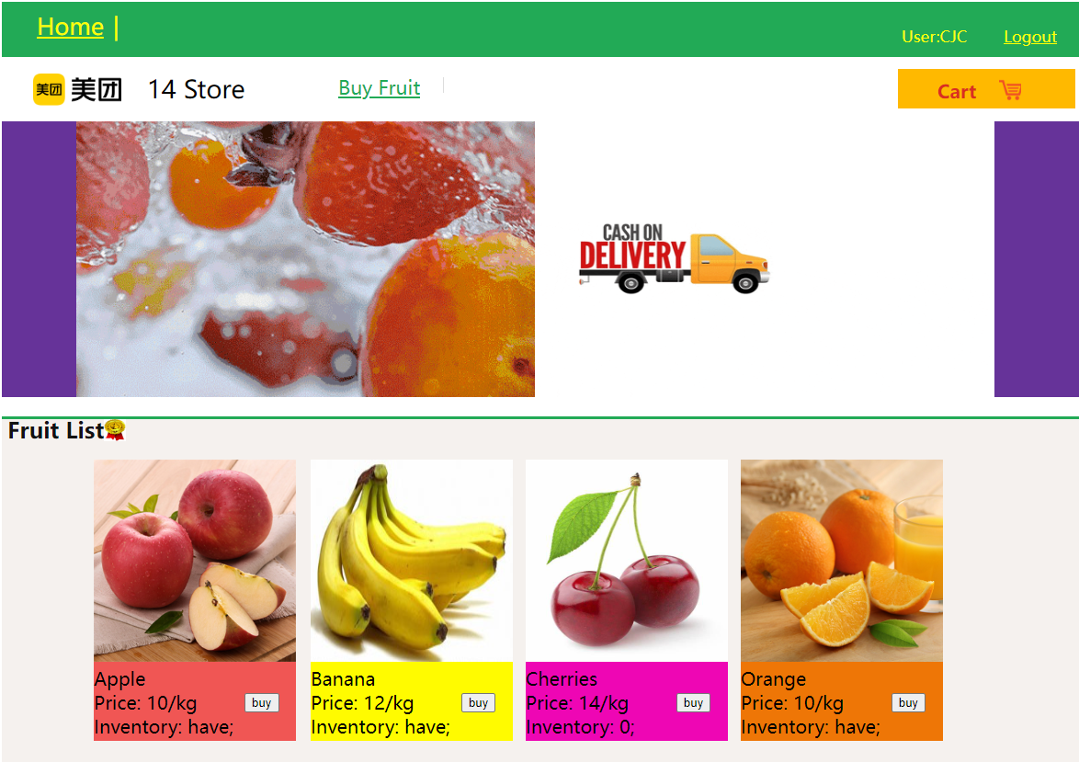
Buyer
Entering
the cart
Picture of fruit
Relevent information:
price / kg
current inventory
胡云珂

Slide 6
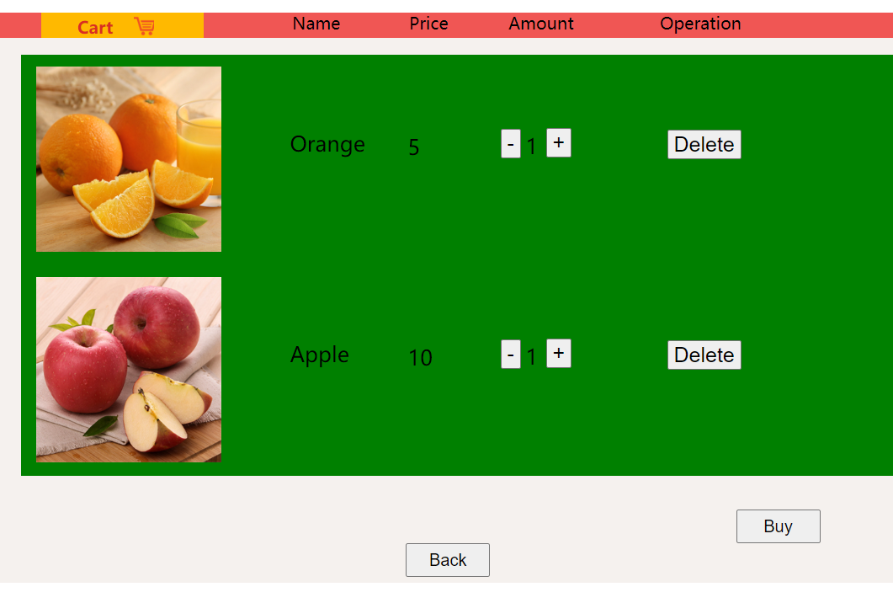
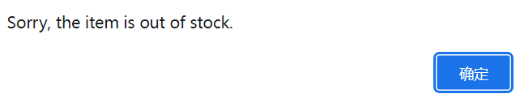
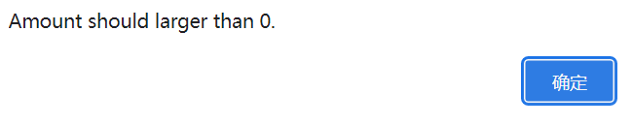
Buyer’s cart
Give warnings if
over the inventory or deleted to
0
Add or delete fruit amount
Delete a certain
type of fruit
from the cart
If we have enough fruits to sell to buyers, buyers can click “Buy” and receive a receipt
胡云珂

Slide 7
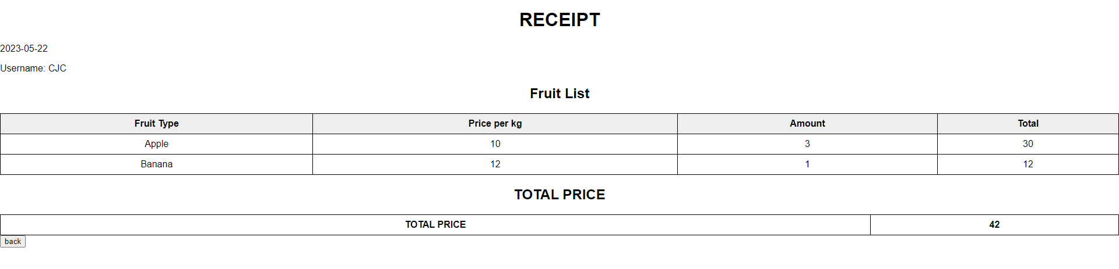
Buyer’s receipt
Calculating price per kg*kg (amount bought) for each type of fruit
Current date & buyer’s username
Adding up the total price
蔡杰超

Slide 8
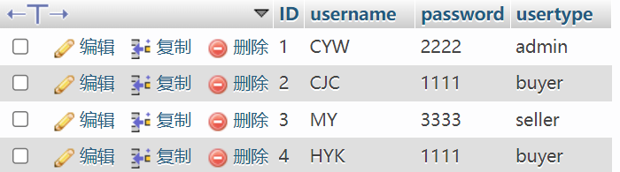
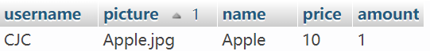
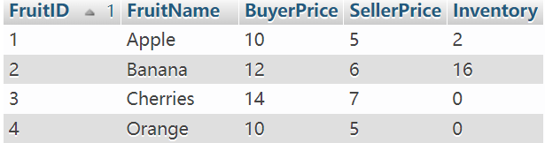
Backend process of buying
Check if the input info matches
info in the SQL “users”
Receiving buyer’s info
and creating a new row
in the SQL “cart”
Printing out receipt according to data in “cart” and refreshing the inventory in SQL “fruit”
蔡杰超

Slide 9
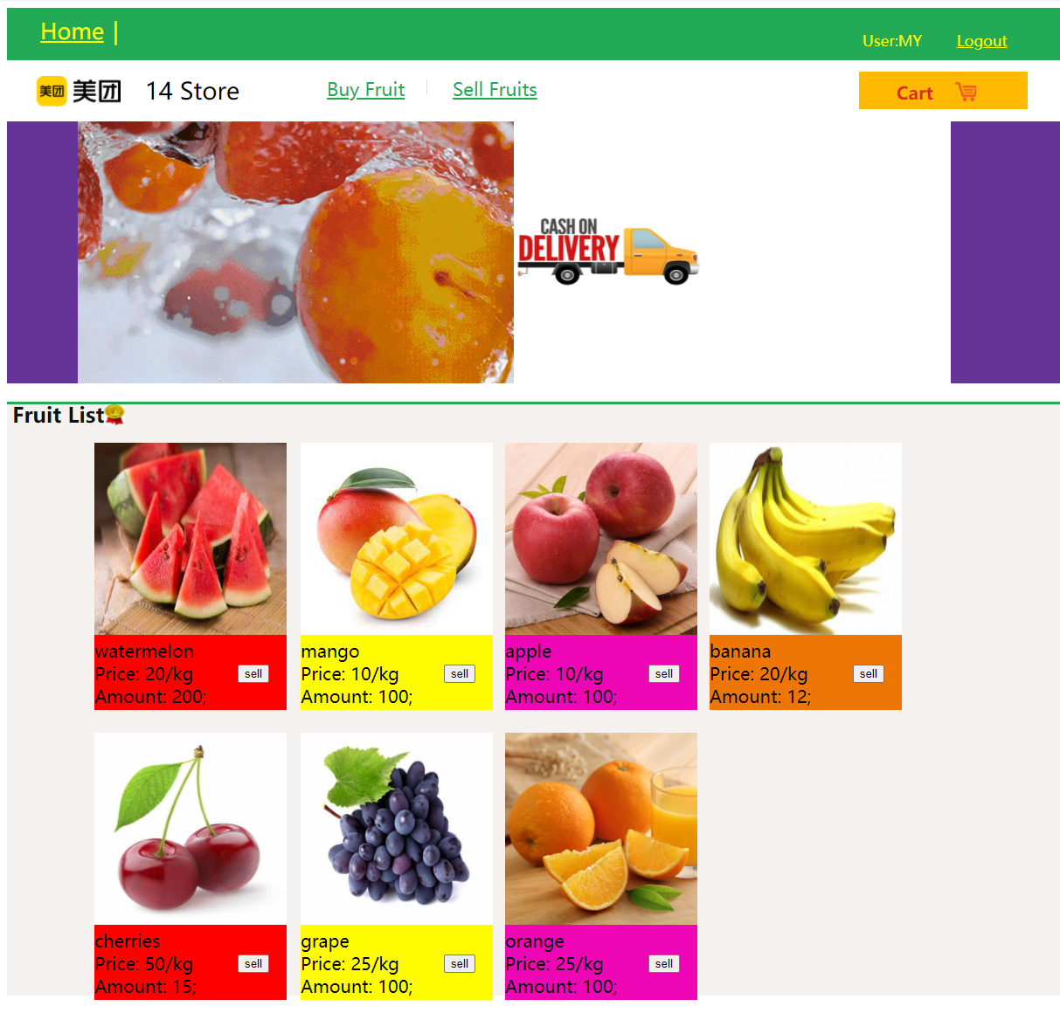
Seller
·the logged in seller
·logging out button
Role: selling fruit to us
Cart: lists all the chosen fruit to be sold
Images of fruits
·Name of fruit
·Seller’s price / kg
·Remaining number of fruit can be sold
“Sell” button

Slide 10
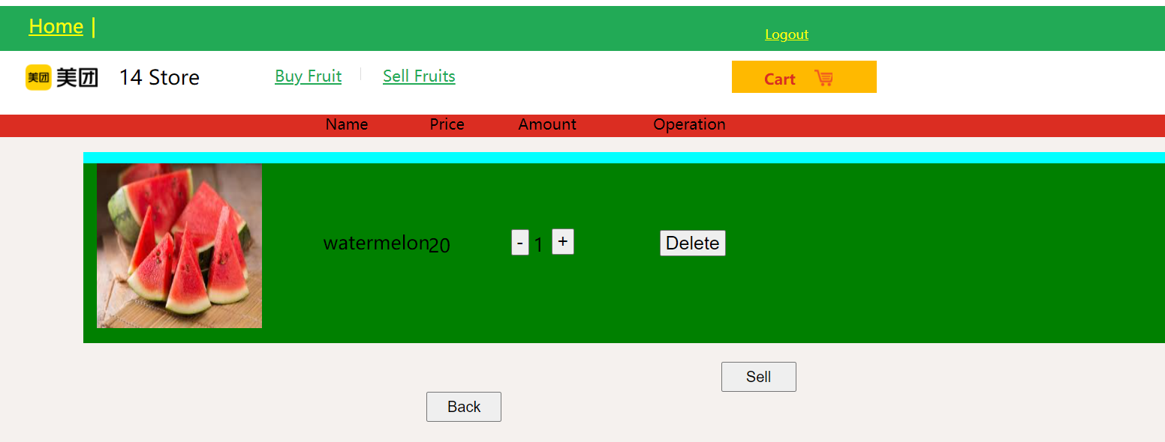

Cart of seller
Giving up selling such kind
of fruit
Clicking to confirm selling
& receive a receipt
·name of fruit to be sold
·selling price / kg
·adding($≤100 kg$) / dropping($≥0 kg$) the amount

Slide 11
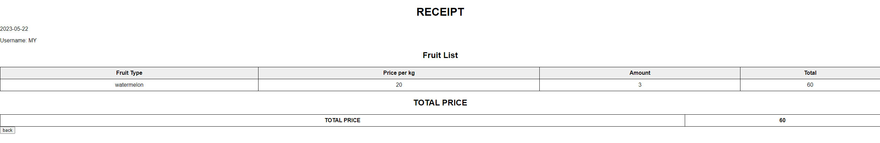
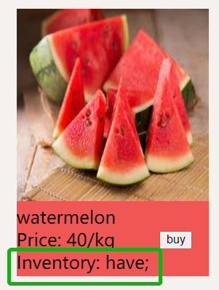
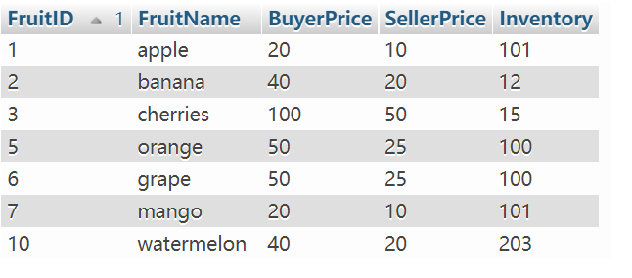
Receipt of seller
Price of each fruit
Sold type
The sold amount / kg
Basic information:
·date of purchase
·purchaser’s name
Total price
The inventory increases

Slide 12
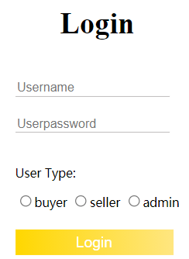
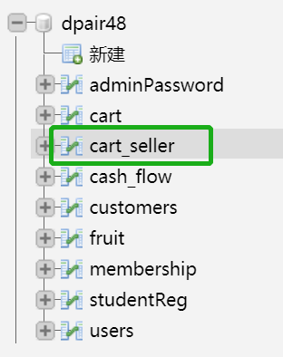
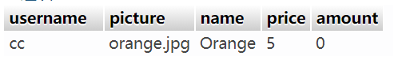
Backend process of buying
Sellers log in
Receiving seller’s information
and creating a new row
in the SQL “cart _ seller”
Printing out receipt according to data in “cart _ seller” and refreshing the inventory in SQL “fruit”

Slide 13
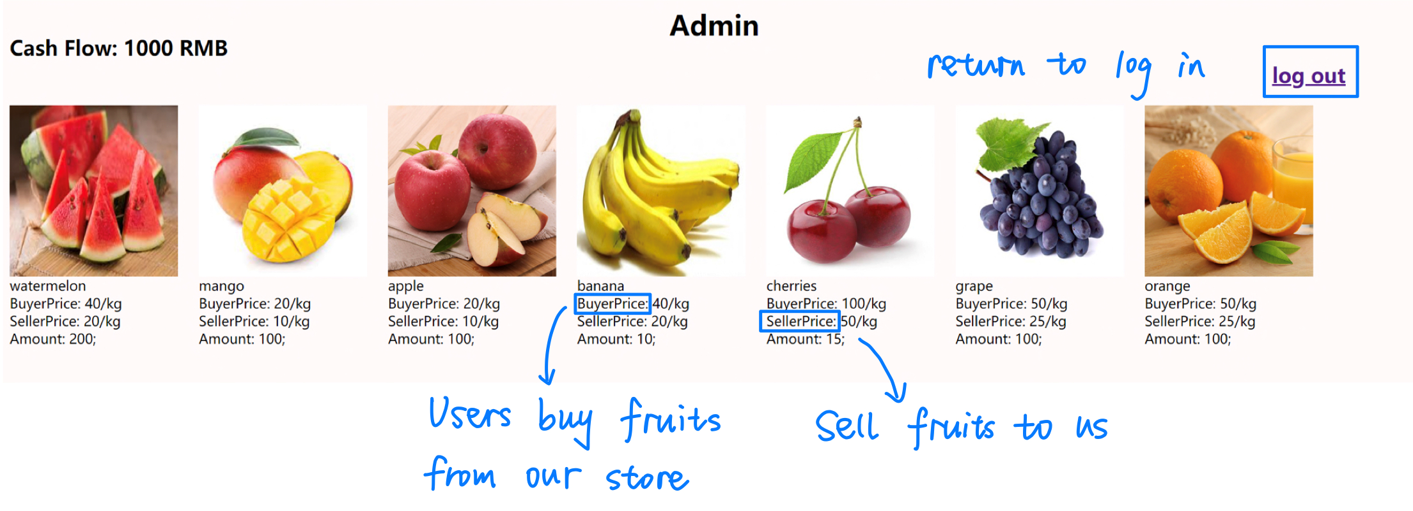
Admin
Show the inventory in a table: how much (in kg) we have, our selling price and our buying price for each fruit.
曹逸玮

Slide 14
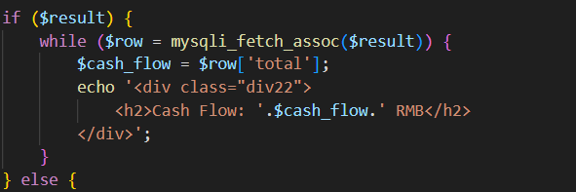
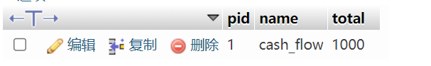
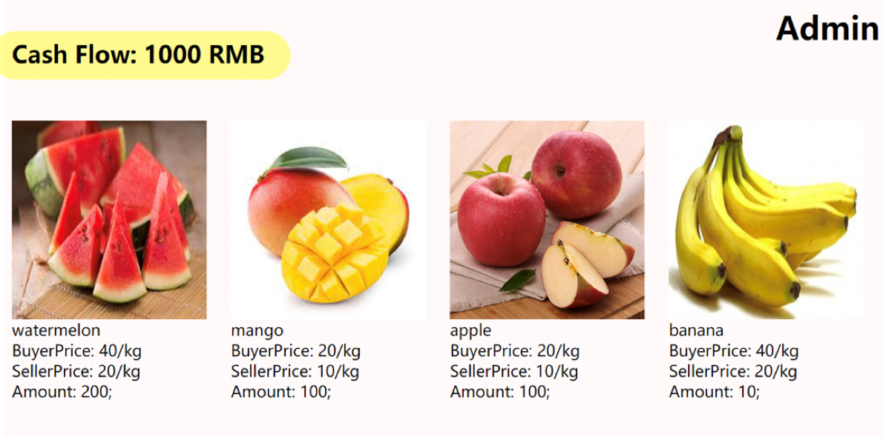
Cash flow
The cash flow of the fruit store is displayed in the upper left corner
曹逸玮

Slide 15


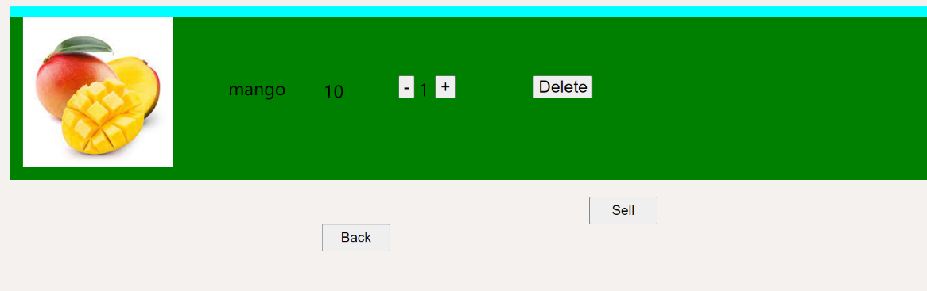
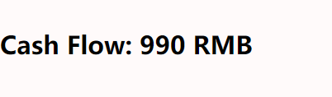
Cash flow
If seller sell a mango the cash flow will be 990
total purchasing price is added to the cash flow amount.
Each time a seller sells to us, the total selling price is subtracted from the cash flow amount.
曹逸玮

Slide 16
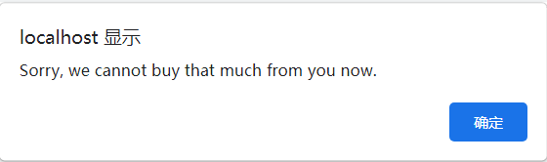
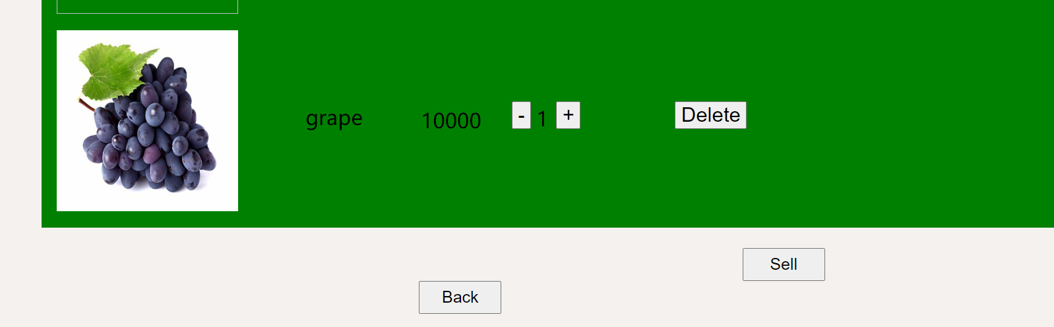
Cash flow
give the warning if we try to buy fruits that cash flow cannot afford
price is 10000
曹逸玮

Slide 17
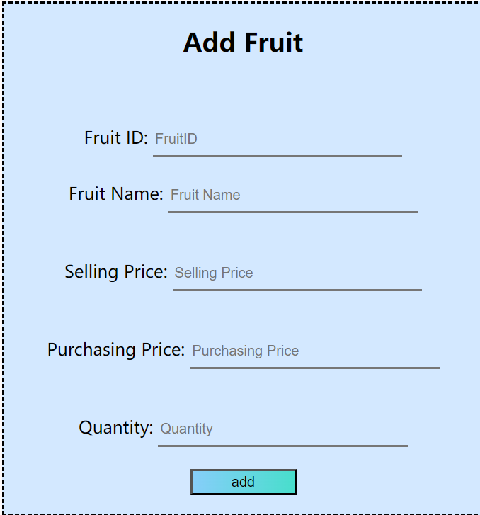
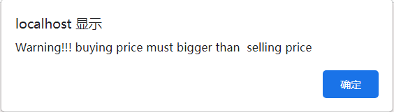
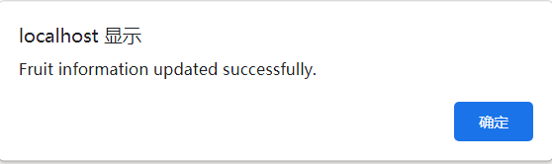
Add fruit
Updates the buyer and seller pages when a fruit is added.
give warning if selling price > buying price
save success message
丁书萱

Slide 18
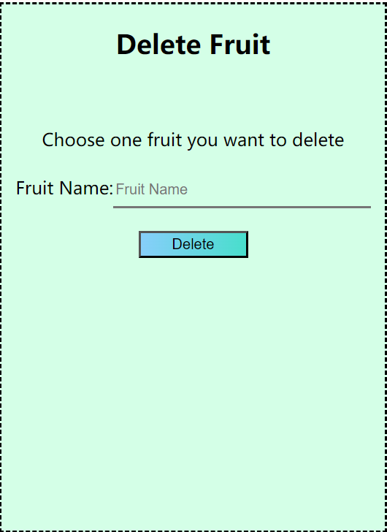
Delete fruit
Updates the buyer and seller pages when a fruit is deleted.
save success message
丁书萱

Slide 19
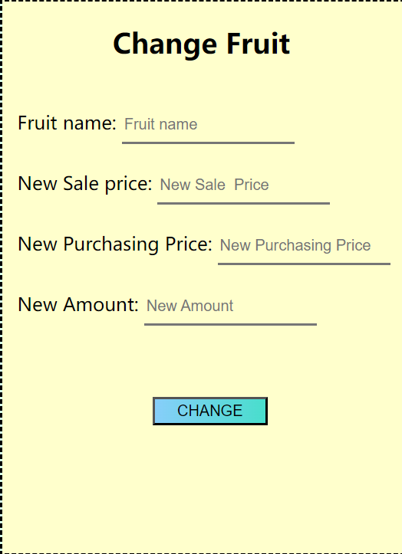
Change fruit
Editing the information on a fruit
give warning if selling price > buying price
save success message
丁书萱

Slide 20
DEMONSTRATION

Slide 21
Thank you for listening

Slide 22
Question
&
answer

